Slide 1
Ramp up Sceneario Automation tools Proposal
Xing Mian

Slide 2
Introduction
The proposed Excel automation tool aims to streamline data extraction and conversion by seamlessly transforming user-input data into standardized formats, represented by ramp up planning table and VRFC table.

Slide 3
Project Description
User Input Fields: (to be discussed)
Time scale (year, quarter, week)
Number of testers
Percentage of
Testing and transiting time (in weeks)
Output Format:
Standardized formats, represented by ramp up planning table and VRFC table.

Slide 4
Project Description
Automation Process:
Normal Flow:
User select the table they want to convert in the tools’ user interface
User input required fields
User specify the file location and file name
User clicks “generate” and the tool will convert the info
User get the output excel files
Validation and Formatting: (to be discussed)
The tool will validate the input data to ensure accuracy and consistency. It will also apply predefined formatting rules to maintain standardization across 2 tables.

Slide 5
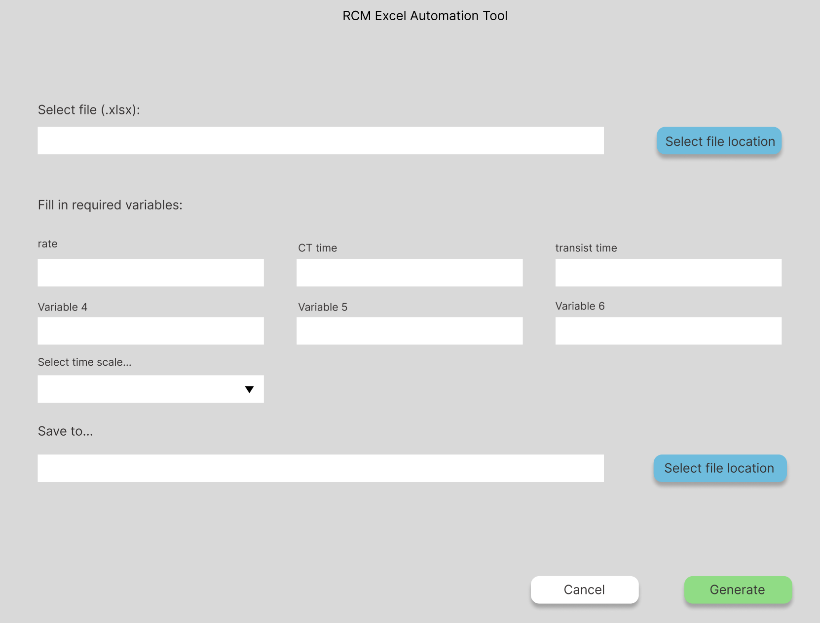
Technical Approach
Python Libraries: openpyxl, pandas, and GUI library
User Interface Mock-up:

Slide 6
Modules by function
User Interface Module:
Implement user input forms and controls for users to input data or specify parameters for Excel sheet generation.
Data Processing Module:
Define functions or classes responsible for processing user-input data.
Implement data validation, transformation, and formatting logic based on the requirements for generating Excel sheets.
Excel Generation Module:
Utilize Python libraries like openpyxl, pandas, or xlsxwriter to dynamically generate Excel sheets based on processed data.
Error Handling Module:
Implement error handling mechanisms to detect and handle exceptions gracefully.

